Slide 1
Classification MOBILE PRICE RANGE PREDICTION
Capstone Project
INDIVIDUAL PROJECT :-
Name :
Rohit Bodkhe
E-mail :
rohitbodkhe6441@gmail.com

Slide 2



Slide 3
Description
In the competitive mobile phone market companies want to understand sales data of mobile phones and factors which drive the prices. The objective is to find out some relation between features of a mobile phone(eg:- RAM, Internal Memory, etc) and its selling price. In this problem, we do not have to predict the actual price but a price range indicating how high the price is.
This kind of prediction will help companies estimate price of mobiles to give tough competion to other mobile manufacturer
Also it will be usefull for Consumers to verify that they are paying best price for a mobile.

Slide 4
Data Description
Battery_power - Total energy a battery can store in one time measured in mAh
Blue - Has bluetooth or not
Clock_speed - speed at which microprocessor executes instructions
Dual_sim - Has dual sim support or not
Fc - Front Camera mega pixels
Four_g - Has 4G or not
Int_memory - Internal Memory in Gigabytes
M_dep - Mobile Depth in cm
Mobile_wt - Weight of mobile phone
N_cores - Number of cores of processor
Pc - Primary Camera mega pixels

Slide 5
Data Description
Px_height - Pixel Resolution Height
Px_width - Pixel Resolution Width
Ram - Random Access Memory in Mega
Touch_screen - Has touch screen or not
Wifi - Has wifi or not
Sc_h - Screen Height of mobile in cm
Sc_w - Screen Width of mobile in cm
Talk_time - longest time that a single battery charge will last when you are
Three_g - Has 3G or not
Wifi - Has wifi or not
Price_range - This is the target variable with value of 0(low cost), 1(medium cost),2(high cost) and 3(very high cost).

Slide 6
About
I have implemented a Mobile Price Prediction using different Machine Learning Algorithms. This project will classify the price range of the mobile price. The price ranges from 0-3. We’ll discuss the price range in the dataset. It's a classification problem. Now I have trained a mobile price classification using different ML algorithms. This model classifies the range of the mobile based on the different parameters like from camera, touch screen, cores, battery, clock speed, internal memory, battery capacity, etc. After training the model using different algorithms, I compared all the models using the graph.

Slide 7
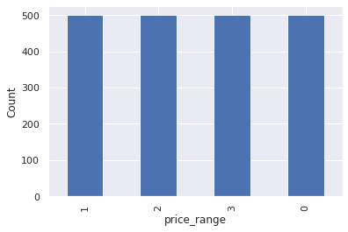
Price Range
There are mobile phones in 4 price ranges. The number of elements is almost similar.

Slide 8
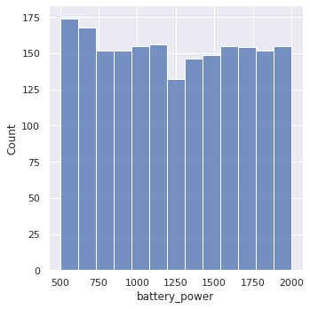
Battery Power
This plot shows how the battery mAh is spread. there is a gradual increase
as the price range increases.

Slide 9
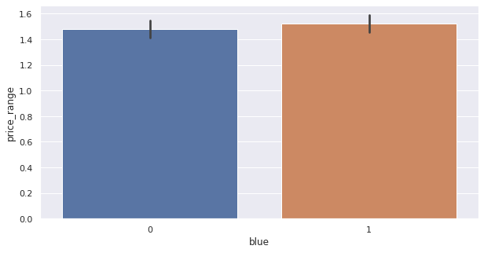
Bluetooth Function
Approximately 50 percent of the devices have bluetooth and half don't have bluetooth in them

Slide 10
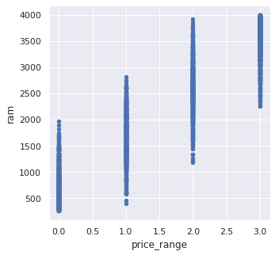
Price Range w.r.t. RAM
RAM has continuous increase with the price range while moving from
Low cost to Very High cost.

Slide 11
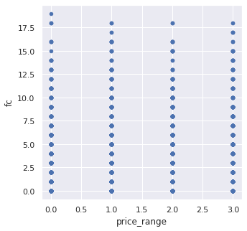
Price Range w.r.t. Front Camera
This features distribution is almost similar along all the price ranges variable,
it may not be helpful in making predictions.

Slide 12
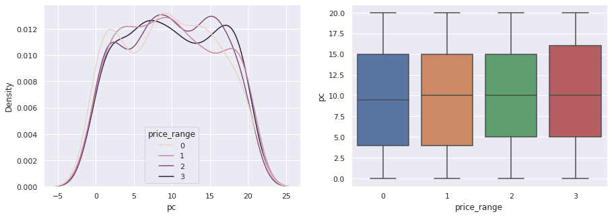
Price Range w.r.t. Primary Camera
Primary camera megapixels are showing a little variation along the
target categories, which is a good sign for prediction.

Slide 13
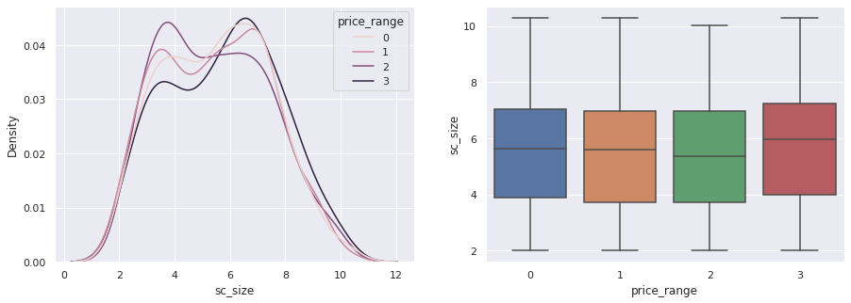
Price Range w.r.t. Screen Size
Screen Size shows little variation along the target variables.
This can be helpful in predicting the target categories.

Slide 14
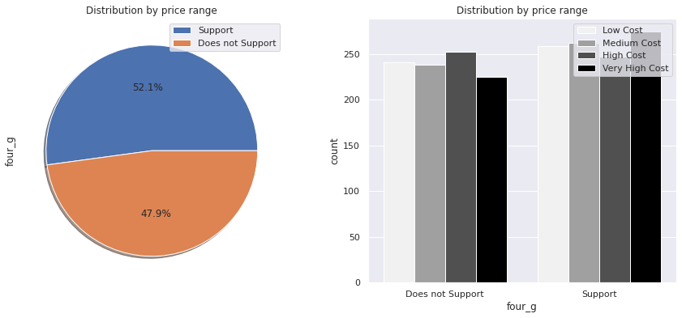
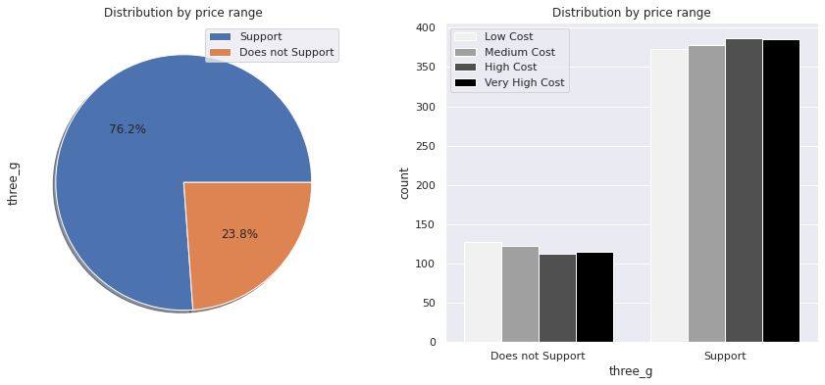
Distribution by 3G and 4G
It can be clearly seen that most of the phones do not 4G but much more phones as compared to the 3G phones which are more in numbers
Approx 76 percent in 3G phones category support it.
Approx 52 percent in 4G phones category support it

Slide 15
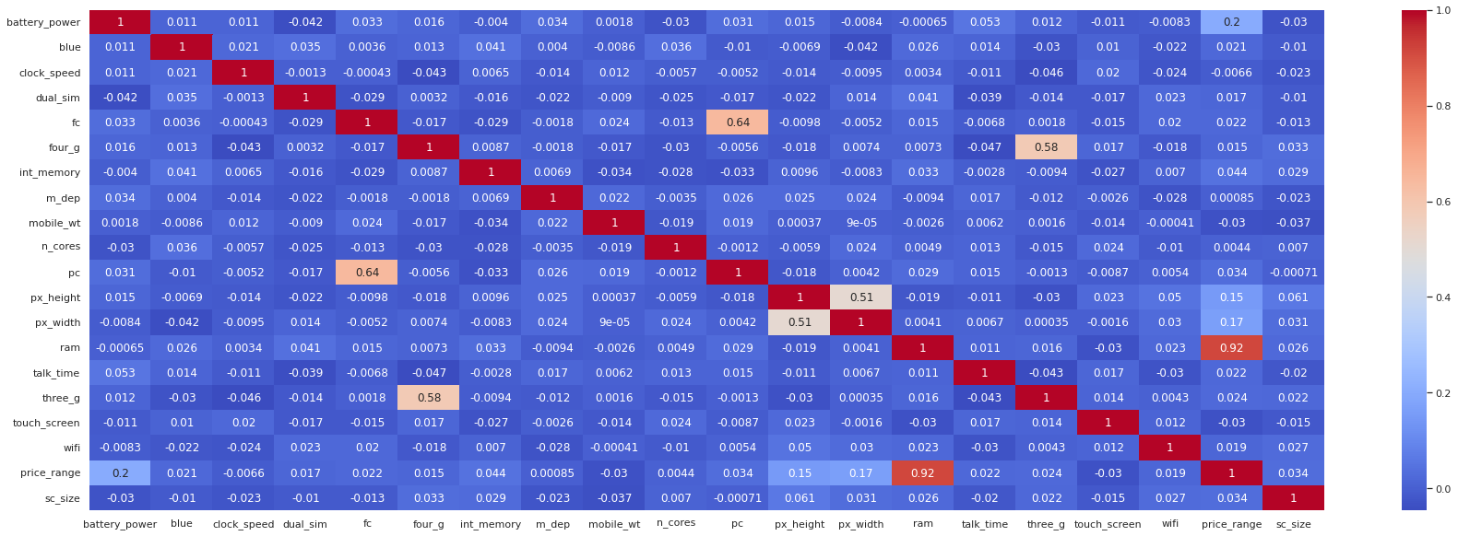
Collinearity

Slide 16
Collinearity
There is some collinearity in feature pairs ('pc', 'fc') and ('px_width', 'px_height'). Both correlations are justified since there are good chances that if front camera of a phone is good, the back camera would also be good.
RAM and price_range shows high correlation which is a good sign, it signifies that RAM will play major deciding factor in estimating the price range.
Also, if px_height increases, pixel width also increases, that means the overall pixels in the screen. We can replace these two features with one feature. Front Camera megapixels and Primary camera megapixels are different entities despite of showing colinearity. So we'll be keeping them as they are.

Slide 17
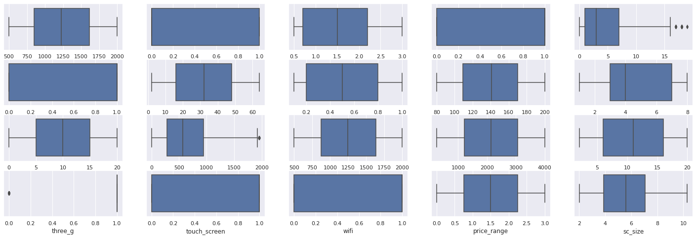
Checking Outliers
Since there are not much outliers, we have directly moved on to test and train of the Dataset

Slide 18
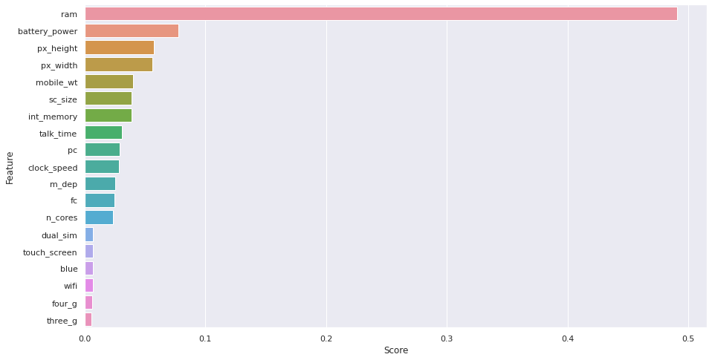
Feature Scoring
This graph clearly shows that the RAM holds more importance with a very large extinct when compared to the other features of the Mobile by achieving the score of approx 0.5

Slide 19
Accuracy Score
Accuracy is one metric for evaluating classification models. Informally, accuracy is the fraction of predictions our model got right.
Accuracy comes out to 0.91, or 91% (91 correct predictions out of 100 total examples). That means our tumor classifier is doing a great job of identifying malignancies.
Our accuracy score for the x_test dataset (Testing Dataset) is
= 0.8825 or 88.25%
Our Accuracy Score for the x_train dataset (Training Dataset) is
= 0.955 or 95.5%
Thus, this score concludes that is very well trained and tested and have an overall good Accuracy Score

Slide 20
Conclusion
From EDA we can see that here are mobile phones in 4 price ranges. The number of elements is almost similar.
Half the devices have Bluetooth, and half don’t
There is a gradual increase in battery as the price range increases
Ram has continuous increase with price range while moving from Low cost to Very high cost
Costly phones are lighter
RAM, battery power, pixels played more significant role in deciding the price range of mobile phone.
Form all the above experiments we can conclude that logistic regression and, XGboosting with using hyperparameters we got the best results

